Slide 1
Terrestrial ecotoxicity assessment of metals: a course
Technical University of Denmark
M. Owsianiak, R.K. Rosenbaum, M.Z. Hauschild

Slide 2
Learning objectives
A participant who has met the objectives of the course will be able to:
Identify processes governing metal fate, accessibility, bioavailability and toxicity in soils
Calculate comparative toxicity potentials of a metal in soil
Utilize this knowledge in regionalized impact assessment

Slide 3
Course structure
Block 1:
A) Characterization models and modeling metal fate (20 min)
Major fate mechanisms for metals is soil (10 min)
Exercise A: calculate fate factor of Cu in 5 soils using USEtox (10 min)
B) Speciation models and modeling metal exposure (20 min)
Structure of speciation models (10 min)
Exercise B: calculate accessibility and bioavailability factors of Cu in 5 soils using empirical regression models (10 min)

Slide 4
Course structure
Block 2:
C) Terrestrial ecotoxicity (20 min)
Structure of terrestrial ecotoxicity models (10 min)
Exercise C: calculate effect factor of Cu in 5 soils using terrestrial biotic ligand models (10 min)
D) Calculation of comparative toxicity potentials (20 min)
Introduction to a case study (5 min)
Case study: calculate weighted CTP for Cu emitted from a power plant (15 min)

Slide 5
Block 1

Slide 6
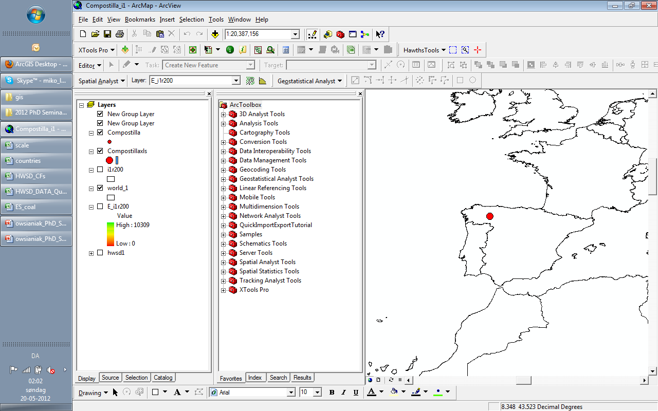
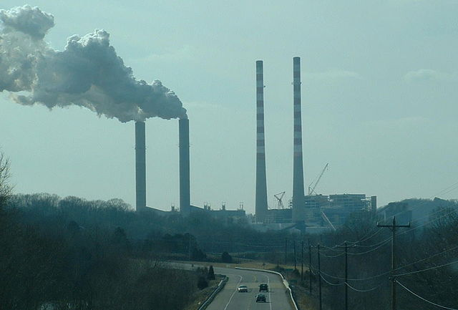
Terrestrial ecotoxicity assessment
What is impact on terestrial ecosystem from a metal emitted to air?

Slide 7


Comparative toxicity potential for organics
  Fate factor (FF)
  how long will a substance stay in soil
  Exposure factor (XF)
  how much of it is available for uptake
  Effect factor (EF)
  how toxic is it to soil organisms

Slide 8
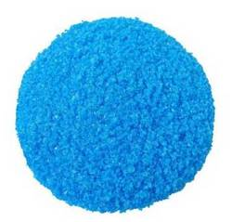
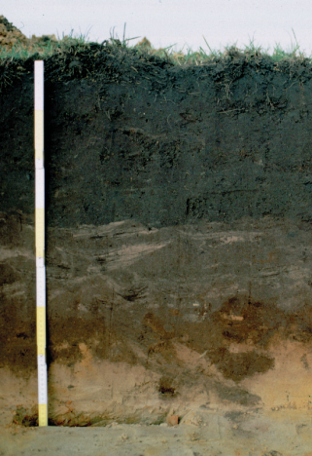
Comparative toxicity potential for metals (in soil)
  Fate factor (FF)
  how long will a metal stay in soil
  Accessibility factor (ACF)
  how much of it is reactive (in the solid phase)
  Bioavailability factor (BF)
  how much of it is available for uptake (in solution)
  Effect factor (EF)
  how toxic is it to soil organisms

Slide 9
Characterization models: USEtox
In USEtox, fate is modeled by solving a system of mass balance equations assuming steady state
we will employ USEtox to calculated fate factor of Cu in 5 soils after unit emission to air

Slide 10
Fate factor
Fate factor (FF) is a residence time (in days) of a metal in top soil (here, first 10 cm) after unit emission to an environmental compartment (here, to air)
emission to air
deposition
runoff to surface water
top soil
leaching to deep soil and groundwater

Slide 11
Exercise A: Calculate fate factors in USEtox
use soil-specific K_{d} values because both leaching and runoff depend on K_{d} (you can look up mass balance equations in the ”Fate” sheet of USEtox)
Emission compartment: continental air; receiving compartment: natural soil
soil | pH | OC (%) | CLAY (%) | K_{d} (L/kg)
1 | 4 | 8 | 66 | 452
2 | 4 | 0.2 | 11 | 1285
3 | 6.4 | 0.3 | 14 | 2225
4 | 7.5 | 1.03 | 61 | 3463
5 | 5.3 | 9.25 | 11 | 343

Slide 12
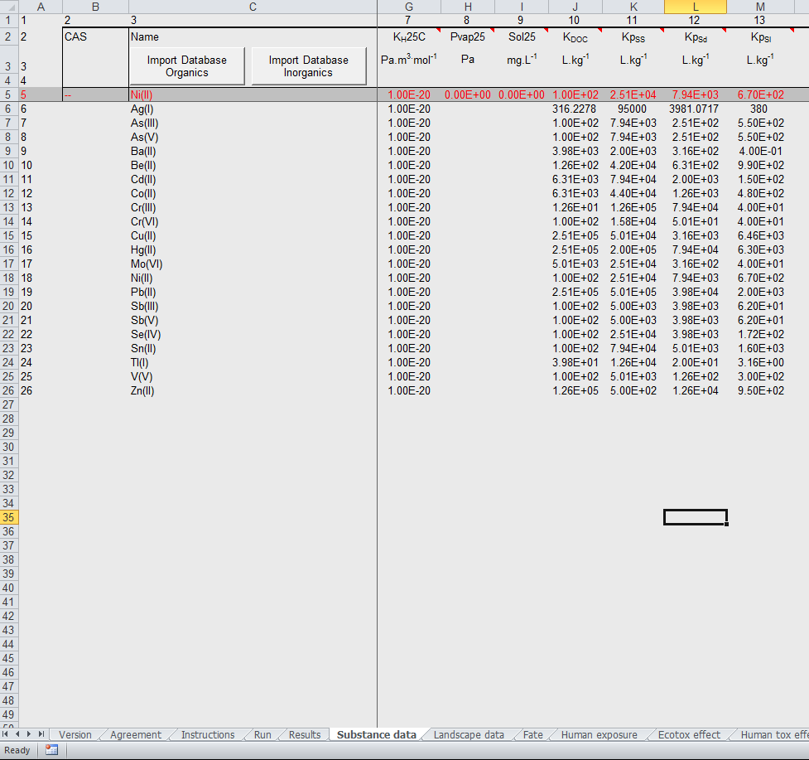
Exercise A: Calculate fate factors in USEtox
Import database for inorganics and change K_{d} value of Cu
K_{d} values are in column M
Cu
Type in K_{d} value for your soil
sheet: substance data

Slide 13
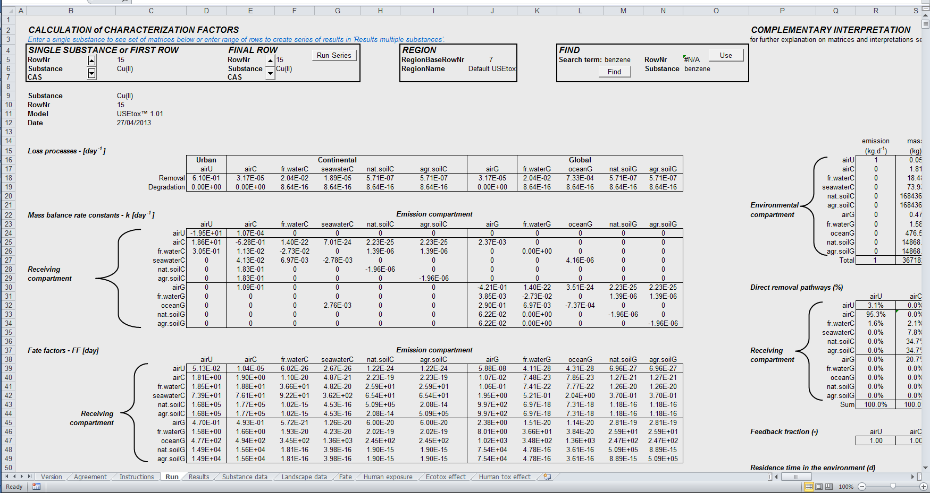
Exercise A: Calculate fate factors in USEtox
select Cu
Fate factor:
sheet: Run

Slide 14
Exercise A: Solution
soil | pH | OC (%) | CLAY (%) | K_{d} (L/kg) | FF (day)
1 | 4 | 8 | 66 | 452 | 20259
2 | 4 | 0.2 | 11 | 1285 | 52880
3 | 6.4 | 0.3 | 14 | 2225 | 83870
4 | 7.5 | 1.03 | 61 | 3463 | 117561
5 | 5.3 | 9.25 | 11 | 343 | 15544

Slide 15
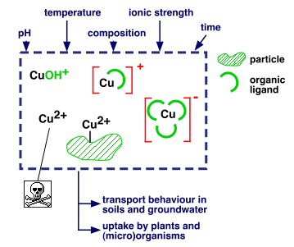
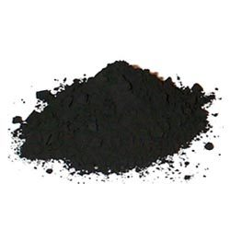
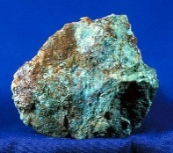
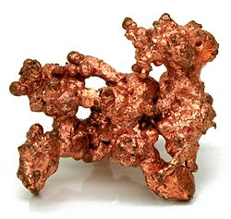
B) Speciation
Cu can exist in many distinct chemical forms, both in the solid phase and in soil pore water
Cu(NO3)2 (aq)
Cu(OH)2 (aq)
Cu(OH)3-
Cu(OH)4-2
Cu+2
Cu2(OH)2+2
Cu2OH+3
Cu3(OH)4+2
CuCl+
CuCl2 (aq)
CuCl3-
CuCl4-2
CuHSO4+
CuNO3+
CuOH+
CuSO4 (aq)
CuSO4·5H₂O
CuO
CuO·SiO₂·2H₂O
  toxic
Cu⁰

Slide 16

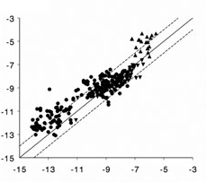
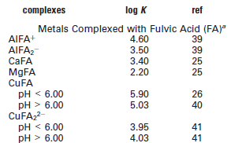
B) Speciation models
1. Multisurface models
relatively accurate
data demanding
software needed
2. Empirical regression models
less accurate
require few input data
easy to use
log(Cu_{free}) mol/L
EMPIRICAL REGRESSION MODEL
log(Cu_{free}) mol/L
WHAM

Slide 17
B) Speciation controls accessibility and bioavailability
Accessibility factor:
Bioavailability factor:

Slide 18
Exercise B: calculate ACF and BF using empirical regression models
assume that organic matter (OM) contains 50% of organic carbon (OC)
assume Cu_{total} = 16 mg/kg
Units: [mg/kg] for reactive and total metal; [%] for organic matter (OM); and [%] for CLAY
Units: [mol/L] and [mol/kg] for free ion and reactive metal, respectively; and [%] for organic matter (OM)

Slide 19
Exercise B: Solution
soil | pH | OC (%) | CLAY (%) | K_{d} (L/kg) | FF (day) | ACF (kg_{reactive}/kg_{total}) | BF (kg_{free}/ kg_{reactive})
1 | 4 | 8 | 66 | 452 | 20259 | 0.36 | 2.3E-05
2 | 4 | 0.2 | 11 | 1285 | 52880 | 0.45 | 7.1E-04
3 | 6.4 | 0.3 | 14 | 2225 | 83870 | 0.44 | 1.5E-06
4 | 7.5 | 1.03 | 61 | 3463 | 117561 | 0.35 | 4.6E-08
5 | 5.3 | 9.25 | 11 | 343 | 15544 | 0.49 | 9.3E-07

Slide 20
Block 2

Slide 21
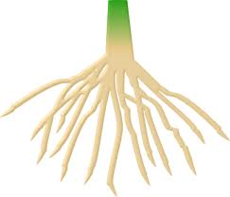
C) Terrestrial ecotoxicity modeling
1. Free ion activity model (FIAM): toxic response is proportional to free ion activity in soil pore water
2. Biotic ligand model (TBLM): toxic response is proportional to the free ion bound to biotic ligand; H+ and base cations alleviate toxicity by competitive binding
Cu²⁺
Cu²⁺
toxic
toxic
biotic ligand
non-toxic
H⁺

Slide 22
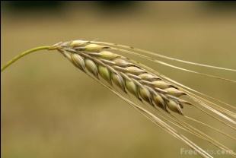
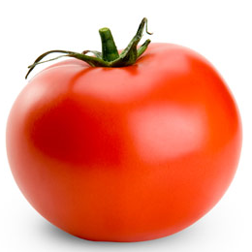
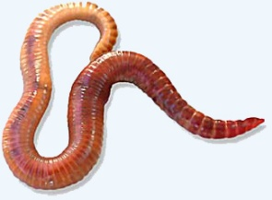
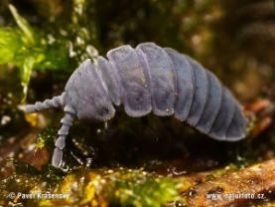


C) Effect factor
Effect factor (EF) is the incremental change in the potentially affected fraction (ΔPAF) of biological species in the soil ecosystem due to exposure to the free ion concentration of metal
HC50 (kg_{free}/m³) is the hazardous free ion concentration affecting 50% of the species, calculated as a geometric mean of free ion EC50 values for individual species.
plants:
invertebrates:
microorganisms:

Slide 23
Exercise C: calculate EF using terrestrial biotic ligand models
calculate EC50 values from soil properties for 6 species
calculate geometric mean of EC50 values, and thereafter the EF
assume {Mg²⁺} = 0.0038 mol/l
Units: [mol/L] for {Mg²⁺} and {Cu²⁺}_{EC50}
 |  |  | TBLM parameters, log₁₀(K_{XBL}) (X-cation; BL-biotic ligand)
Metal | Organism | Toxic endpoint | f₅₀ | β | {Me} | {H⁺} | {Ca²⁺} | {Mg²⁺} | { Na⁺}
Cu | barley (Hordeum vulgare cv. Regina) | BRE: root elongation, 4-d EC50 | 0.05 | 0.96 (0.11) | 7.41 (0.23) | 6.48 (0.26) | - | - | -
Cu | tomato (Lycopersicon esculentum cv. Moneymaker) | TSY: shoot yield, 21-d EC50 | 0.05 | 1.11 (0.16) | 5.65 (0.10) | 4.38 (0.21) | - | - | -
Cu | redworm (Eisenia fetida) | FJP: juvenile production, 4-w EC50 chronic | 0.05 | 0.70 (0.08) | 4.62 (0.12) | 2.97 (0.62) | - | - | -
Cu | springtail (Folsomia candida) | ECP: cocoon production, 4-w EC50 chronic | 0.05 | 1.14 (0.15) | 6.50 (0.25) | 5.9 (0.29) | - | - | -
Cu | soil microbes | GIR: glucose induced respiration, 7-d EC50 | 0.05 | 0.58 (0.07) | 6.69 (0.10) | 7.5 1) | - | - | -
Cu | soil microbes | PNR: potential nitrification rate, 7-d EC50 | 0.05 | 0.78 (0.13) | 4.93 (0.48) | 4.45 (0.58) | - | 1.64 (5.80) | -

Slide 24
Solution:
soil | pH | OC (%) | CLAY (%) | K_{d} (L/kg) | FF (day) | ACF (kg_{reactive}/kg_{total}) | BF (kg_{free}/ kg_{reactive}) | EF (m³/ kg_{free})
1 | 4 | 8 | 66 | 452 | 20259 | 0.36 | 2.3E-05 | 4879
2 | 4 | 0.2 | 11 | 1285 | 52880 | 0.45 | 7.1E-04 | 4894
3 | 6.4 | 0.3 | 14 | 2225 | 83870 | 0.44 | 1.5E-06 | 77079
4 | 7.5 | 1.03 | 61 | 3463 | 117561 | 0.35 | 4.6E-08 | 121942
5 | 5.3 | 9.25 | 11 | 343 | 15544 | 0.49 | 9.3E-07 | 28319

Slide 25
Comparative toxicity potentials
soil | pH | OC (%) | CLAY (%) | K_{d} (L/kg) | FF (day) | ACF (kg_{reactive}/kg_{total}) | BF (kg_{free}/ kg_{reactive}) | EF (m³/kg_{free}) | CTP (m³/kg_{emitted}·day)
1 | 4 | 8 | 66 | 452 | 20259 | 0.36 | 2.3E-05 | 4879 | 817
2 | 4 | 0.2 | 11 | 1285 | 52880 | 0.45 | 7.1E-04 | 4894 | 83736
3 | 6.4 | 0.3 | 14 | 2225 | 83870 | 0.44 | 1.5E-06 | 77079 | 4262
4 | 7.5 | 1.03 | 61 | 3463 | 117561 | 0.35 | 4.6E-08 | 121942 | 231
5 | 5.3 | 9.25 | 11 | 343 | 15544 | 0.49 | 9.3E-07 | 28319 | 201

Slide 26
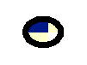
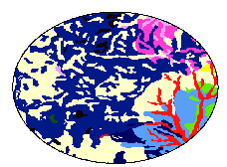
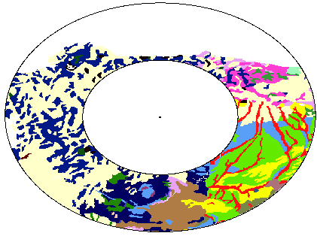
D) Case study: calculate weighted CTP for Cu emitted from a power plant
Metal deposition ocurrs mainly within 200 km from the source
Weighting of CTP based on deposition load and relative ocurrence of soils is necessary
% ocurrence of soil i in area a (w_{si,ai})
soil | a₁ 0-1 km | a₂ 1-100 km | a₃ 100-200 km
soil 1 | 25 | 58 | 35
Soil 2 | 75 | 37 | 30
Soil 3 | 0 | 0 | 10
Soil 4 | 0 | 0 | 12
Soil 5 | 5 | 5 | 3
soil 1
soil 2
soil 3
soil 4
soil 5

Slide 27
D) Case study: calculate weighted CTP for Cu emitted from a power plant
assume deposition load as in table below
% mass deposited in area a (w_{ai})
area | % total mass deposited
0-1 km | 13
1-100 km | 83
100-200 km | 4

Slide 28
Solution
Soil-weighted CTPs in each area:
Area-weighted CTP:
CTP that can be applied in regionalized impact assessment

Slide 29
Take home messages
Comparative toxicity potentials of metals in soil is controlled by soil properties
Deposition area for airborne metal emissions can be large
Weighting of CTPs should be done based on the relative occurrence of soils

